Slide 1

Course Alignment Process in Backward Design
Venue: OCB237
Date: Aug 3
Time: 11am – 12 noon
Presenters: Mary Burkart and Sharon Gan

Slide 2

View this PPT on Your Device
You will need a QR code reader

Slide 3

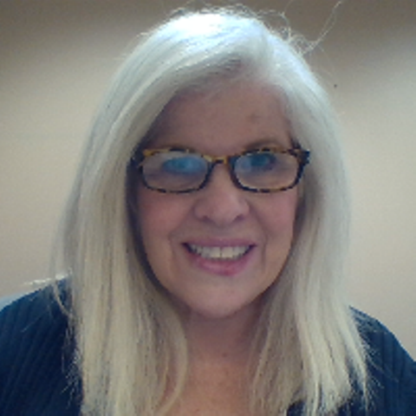
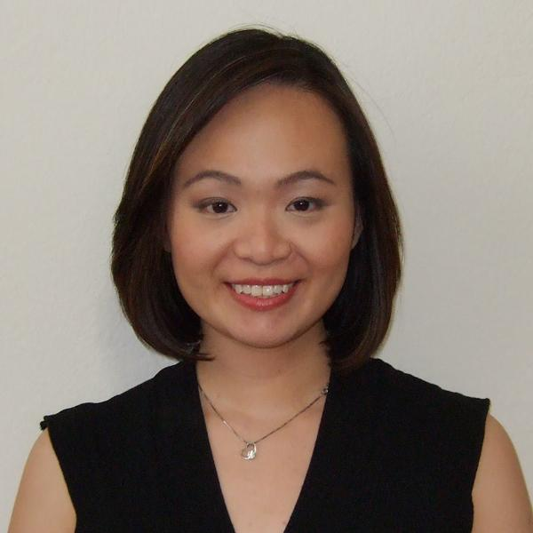
Who We Are
Mary Burkart
Instructional Designer
Mary.Burkart@Park.edu
Sharon Gan
Instructional Designer
Sharon.Gan@Park.edu

Slide 4
Course Development Process
Development Contract Awarded
  Redevelopment
  New development
First Meeting
  E-mail/F2F
  Workspace
  Discuss 11-week development
Phase 1 Development
  Course Alignment plan
  Mapping of learning experience and resources
Phase 2 Development
  Build the Canvas course shell
  Review and update Course Alignment plan
Phase 3 Review & Approval
  Review Course Alignment plan
  Developer
  Department
  Quality Review
Course Goes Live
  Course master duplicated into live sections for upcoming term

Slide 5
Course Alignment Plan
    Meet HLC requirement
    Check cognitive levels with Bloom’s Taxonomy
    Designing for the course, not to the text
    Plan for scaffolding and chunking from the start
    Improve inclusivity with Universal Design for Learning

Slide 6

Criterion 4. Teaching and Learning: Evaluation and Improvement
4.B. The institution demonstrates a commitment to educational achievement and improvement through ongoing assessment of student learning.
The institution has clearly stated goals for student learning and effective processes for assessment of student learning and achievement of learning goals.
The institution assesses achievement of the learning outcomes that it claims for its curricular and co-curricular programs.
The institution uses the information gained from assessment to improve student learning.
The institution’s processes and methodologies to assess student learning reflect good practice, including the substantial participation of faculty and other instructional staff members.

Slide 7
Course Alignment Plan
    Meet HLC requirement
    Check cognitive levels with Bloom’s Taxonomy
    Designing for the course, not to the text
    Plan for scaffolding and chunking from the start
    Improve inclusivity with Universal Design for Learning

Slide 8
Course Alignment Process
Distill core concepts from course description
Compare core concepts against CLOs
Discuss Core Assessment
Distill key concepts from each CLO
Write ULOs to support assessment of key concepts
Plan learning experiences to introduce key concepts
Plan learning experiences to reinforce key concepts

Slide 9
Introduce, Reinforce, Assess (IRA)
Introduce | Reinforce |  | Assess
Readings Articles Videos Websites | Readings Articles Videos Infographic Practice Exercises Discussion Quiz | Reflection/Journal Assignment Scaffolded CA Assignment Core Assessment Project/Paper, other | Discussion Quiz Reflection/Journal Assignment Scaffolded CA Assignment Exam Group Project Core Assessment Project/Paper

Slide 10


Course Alignment Plan -Formats
ID-FACING
FACULTY-FACING

Slide 11
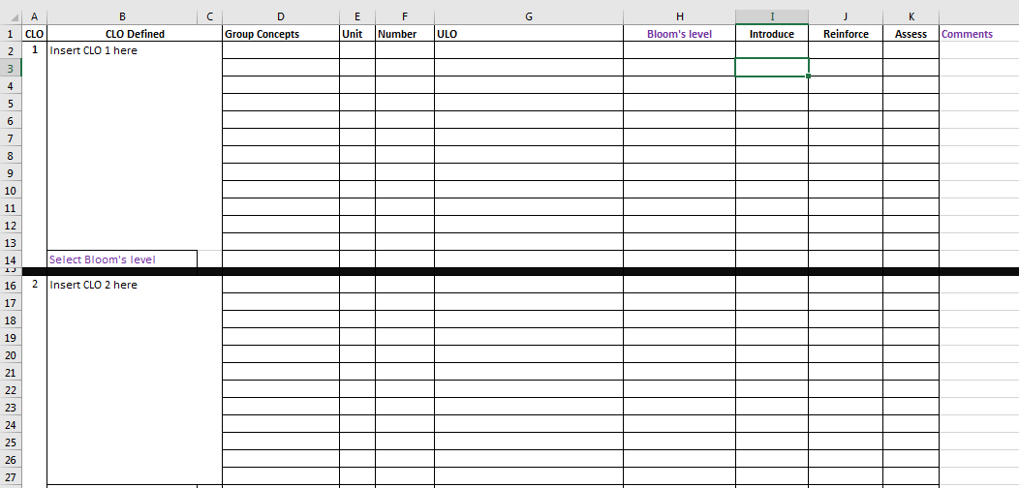
CLO-ULO-IRA Plan –ID Excel Format

Slide 12
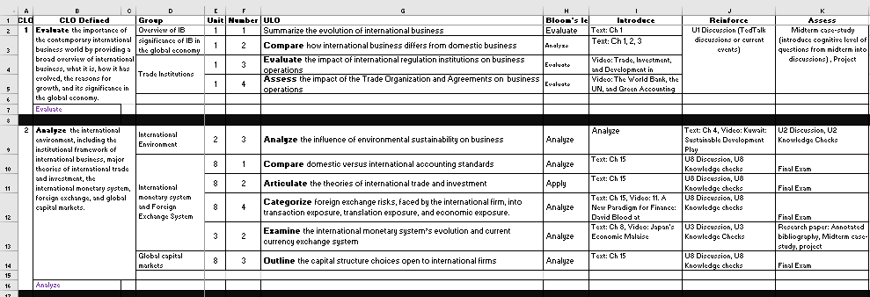
CLO-ULO-IRA Plan –ID Excel Format

Slide 13
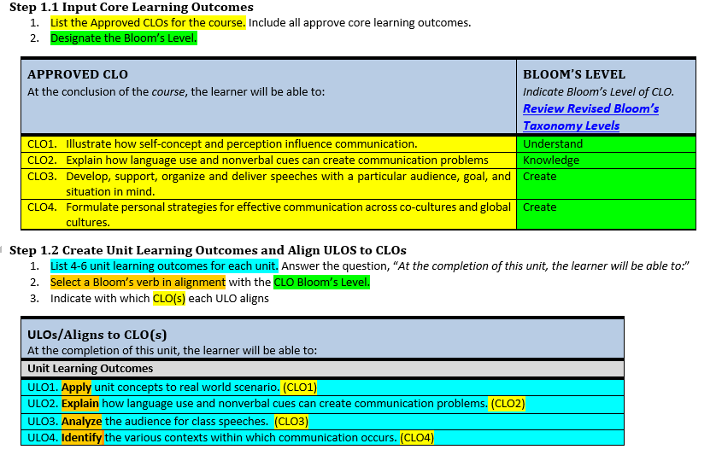
CLO-ULO-IRA Plan - Faculty Word Format

Slide 14
CLO-ULO-IRA Plan - Faculty Word Format

Slide 15
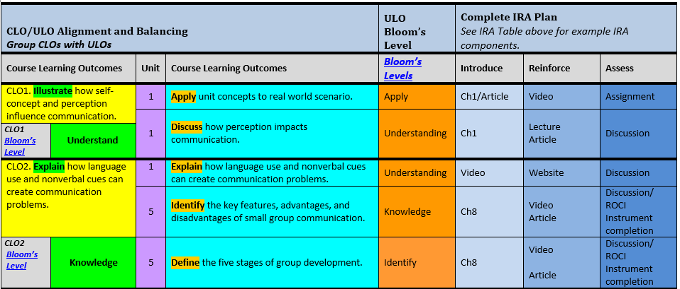
CLO-ULO-IRA Plan - Faculty Word Format

Slide 16
Faculty Testimonial - Alignment Plan
Between May and July 2018, I used Park’s Instructional Designers CLO-ULO planning spreadsheet and the Canvas workspace for the first time as faculty in developing International Negotiations course under the guidance of Dr. Sharon. These were great tools to use for the first time as a course developer. Both of these tools enabled us to work form the same document where I could share course content and receive constructive feedback from Sharon with ease instead of email. Except for meeting appointments, we never used email to discuss course content matters. I also liked the idea that we could hold Zoom meetings during to help share what was needed and more so HOW. I would highly recommend using these tools for course development in the future. At the moment, I do not have any suggestions for improvement but was really impressed with the level of interaction and ease the tools provided during course development. In my view, from the faculty standpoint, this was a well thought idea of improving the process course development.
Dr. Kennedy Maranga
July 23rd, 2018

Slide 17
Faculty Testimonial - Workspace
While I have been developing courses for other universities for many years, GB501 was the first course that I developed for Park University. The Canvas platform provided a unique opportunity for me to see the breakdown of tasks associated with each of the modules. The time frame of which to complete each of these was appropriate. One of the greatest tools was having the workspace as well as the course shell. This allowed me to input what I had completed for review in the workplace and then see the course unfold as piece by approved piece, it would be placed into the shell. This helped me to see the "final product" as we moved forward in the development process and helped guide me as to what path I should take to ensure that the course flowed properly. The workspace served as a comprehensive guide to each of the tasks that needed to be included in the modules. Sharon was an excellent resource as she provided timely feedback and guidance throughout the process which allowed me to continue working and making progress as we kept the end goal in mind.
Dr. Cheryl Chance,
July 20, 2018

Slide 18
Faculty Testimonial - Alignment Plan
The CLO-ULO-Assessment/IRA map helped to serve as a checks and balances in the development of the course.
Having this tool ahead of the development process, helps us to keep in mind what needs to be done in order to meet the requirements of a successful course. This prevents any elimination of key points only to be otherwise discovered at the end of the course development process.
Dr. Cheryl Chance,
July 21, 2018

Slide 19
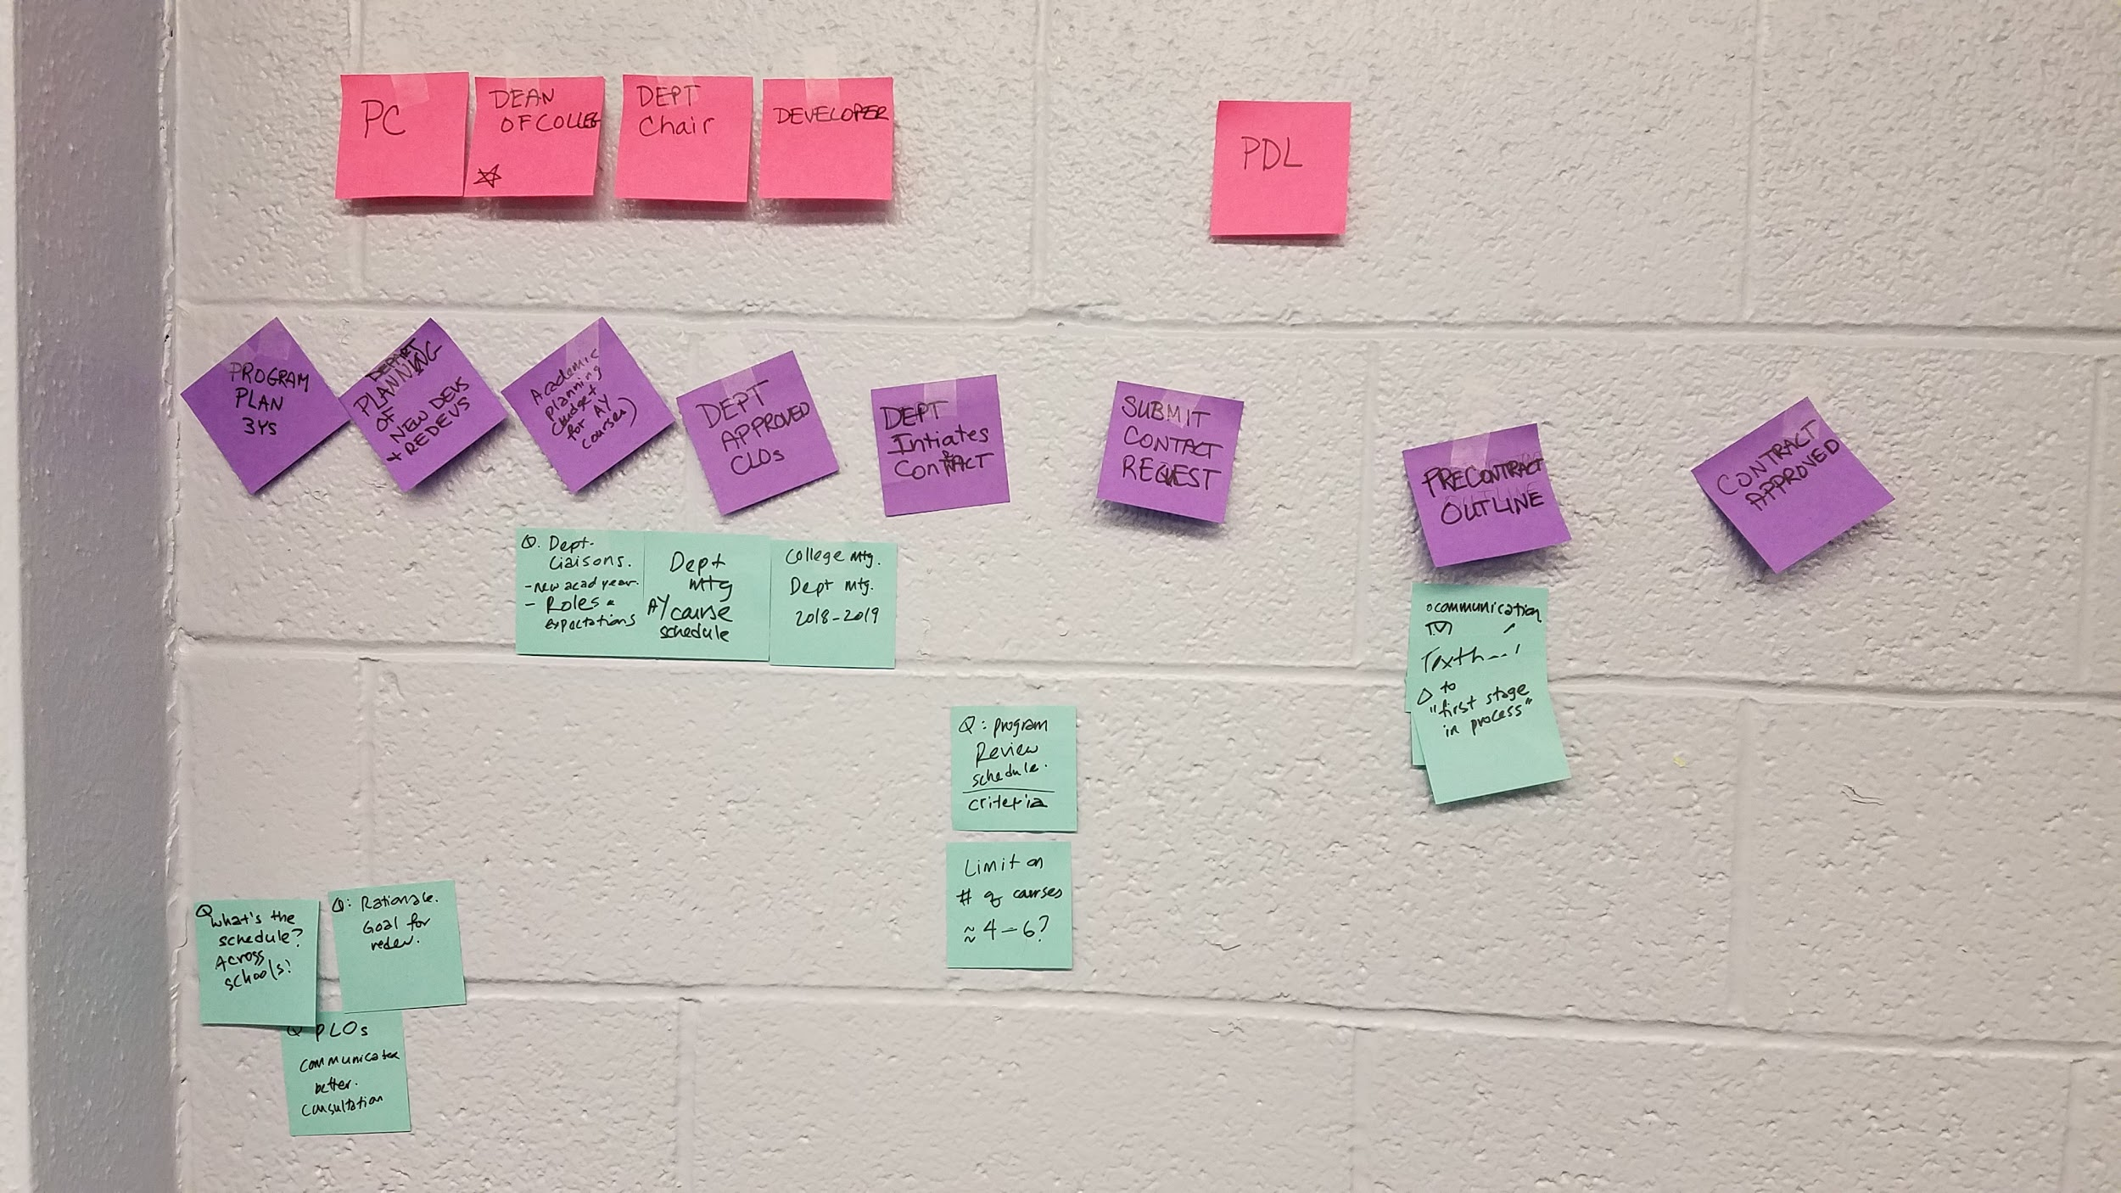
Lessons Learned
Work off the same Bloom’s list and definitions
IDs need to be involved further “upstream”
Upstream

Slide 20
Going Forward
Process
Agree on the same Bloom’s list and definitions
Present benefits of IDs in “upstream” involvement
Alignment Map
Reduce content-silos by changing “ULOs” to “SLOs”

Slide 21


View Templates
Excel Format
Word Format

