Slide 1

StreamAligning the Course Development Process
Collaborate
Develop
Evaluate
Aligning the Course Development Process with Quality Review and Course Design Workspace 2.0
Mary Burkart, Instructional Designer
Park University
August 3, 2018

Slide 2

Workspace 1.0 ➔ Workspace 2.0
Workspace 1.0 was implemented in 2016 to
Move course design from e-mail to Canvas
Provide space for
  Course design
  Collaboration
  Content submission
  Evaluation
Workspace 2.0 enhancements
Support greater alignment to strategic plan and course outcomes
Inform CDEVs of the quality standards for excellence early in the process
Include formative quality reviews to ensure the summative quality review is successful
Clarify the process with streamlined sequencing, instructions, and templates
Facilitate more collaboration among
stakeholders
New

Slide 3

Stakeholders
Course Developer (CDEV)
  Provides subject matter expertise and course content
Instructional Designer (ID)
  Provides instructional design consultation services
  Reviews course content for alignment
  Builds courses and applies the Park Course Template

Slide 4
Stakeholders
Departmental Content Approver
  Reviews course outline for alignment to department goals
  Reviews and approves final course
As required by expertise
  Other IDs
  Librarian

Slide 5
The Spaces: Collaboration Process
First meeting
Establish course goals
Introduce the course development process
Introduce the Course Alignment Plan (formerly CLO-ULO Map)
Collaborate on student learning outcomes
Explore course assessment options
Explore resources (OERs, third party tools, etc.)
Follow-up meetings
Review alignment

Slide 6
The Spaces: Content Development
Instructional Designer
Consult on instructional design of content
Manage alignment to Course Alignment Plan
Workspace
Keeps track of deadlines, submissions
Facilitates easy version control
Course Developer
Submit content to the Workspace, guided by templates
  Course Alignment Plan (Previously known as CLO-ULO Map)
  Course Outline
  Course Content

Slide 7
The Spaces: Evaluate
The Course Design Team review ensures that the design concepts satisfy academic departmental design specifications.
Initial Review with Departmental Content Approver and Course Developer
Course outline document
Course Alignment Plan (CLO-ULO-IRA Plan)
Comprehensive Team Review when development is complete
Content review
Course design evaluation (QSR)

Slide 8

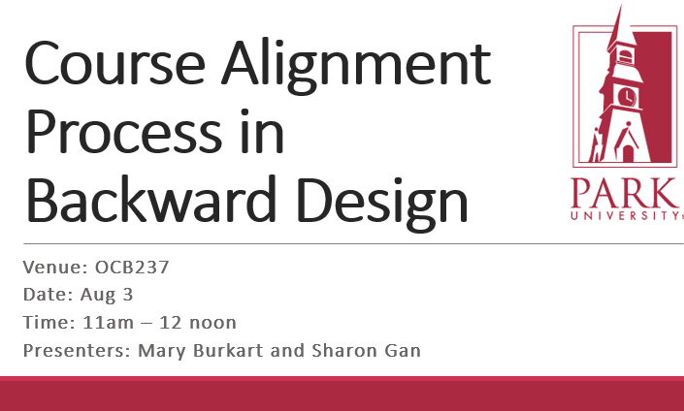
StreamAligning the Course Development Process
Find out more at our session:
Thank you!
Questions?
Feedback?
Suggestions?

